Slide 1
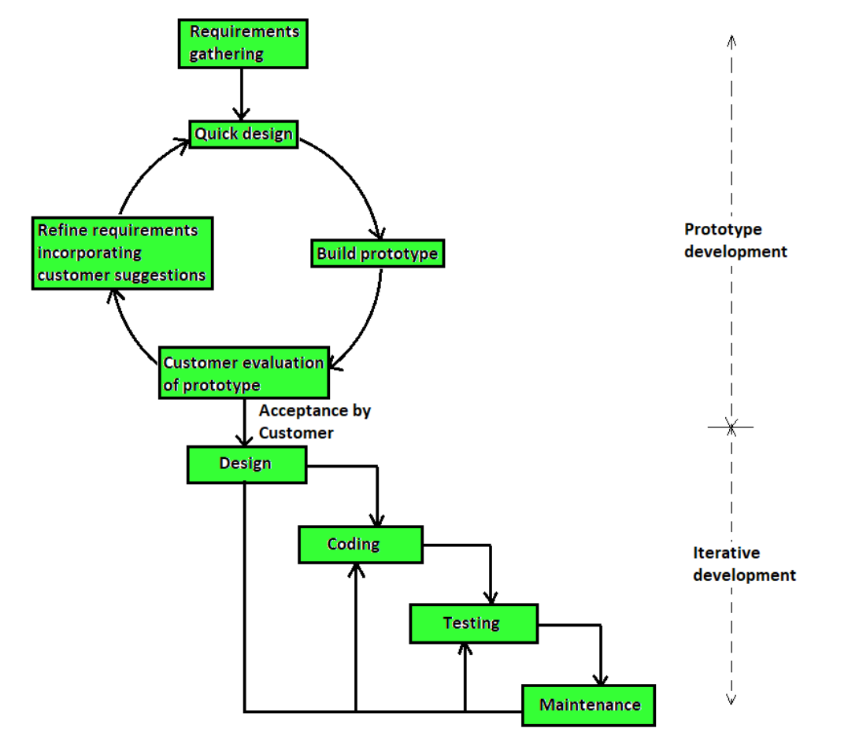
Prototyping Model – Software Engineering

Slide 2
Important Points:
Customer Not Clear with idea
Throwaway Model
good for technical and requirement risks
Increase in Cost of Development

Slide 3
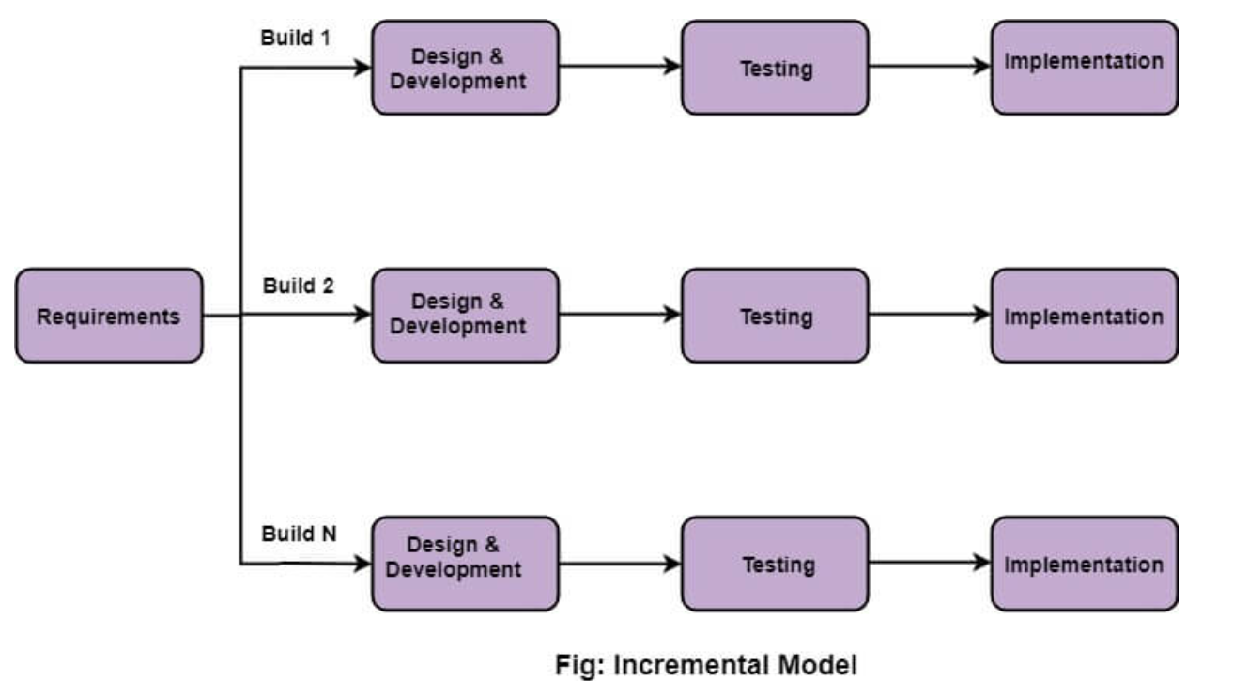
Incremental Model – Software Engineering

Slide 4
Important Points:
Module by Module Working
Customer Interaction Maximum
Large projects
Early Release Product Demand
Flexible to changes

Slide 5
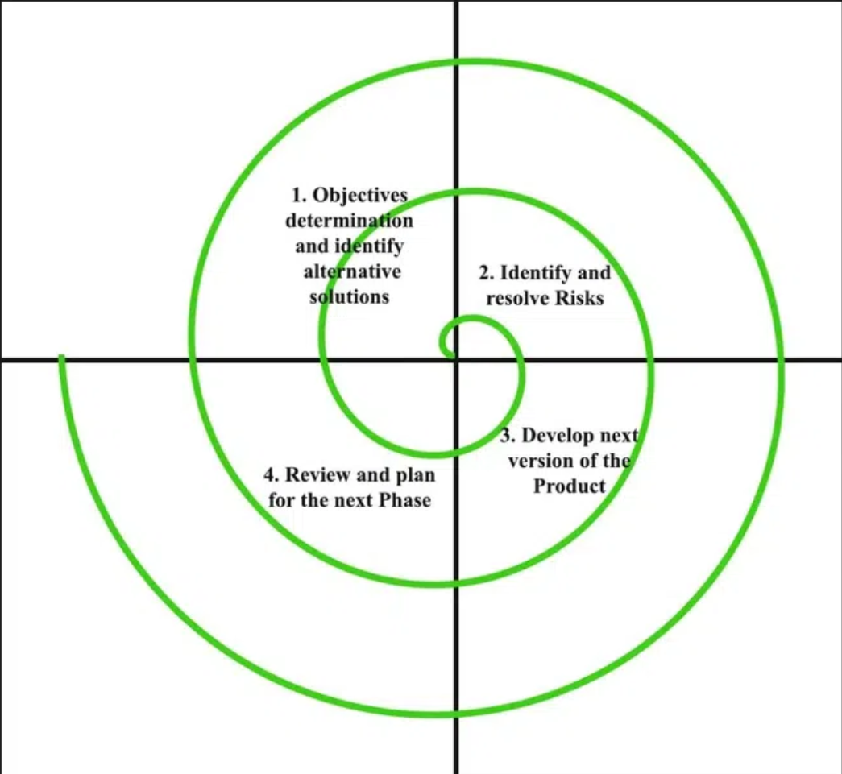
Spiral Model – Software Engineering

Slide 6
Important Points:
Risk Handling
Radius of spiral = Cost
Angular Dimension = Progress
Meta model
Advantages
Risk Handling
Large Projects
Flexible
Customer satisfaction
Disadvantages
Complex
Expensive
Too much Risk Analysis
Time

Slide 7
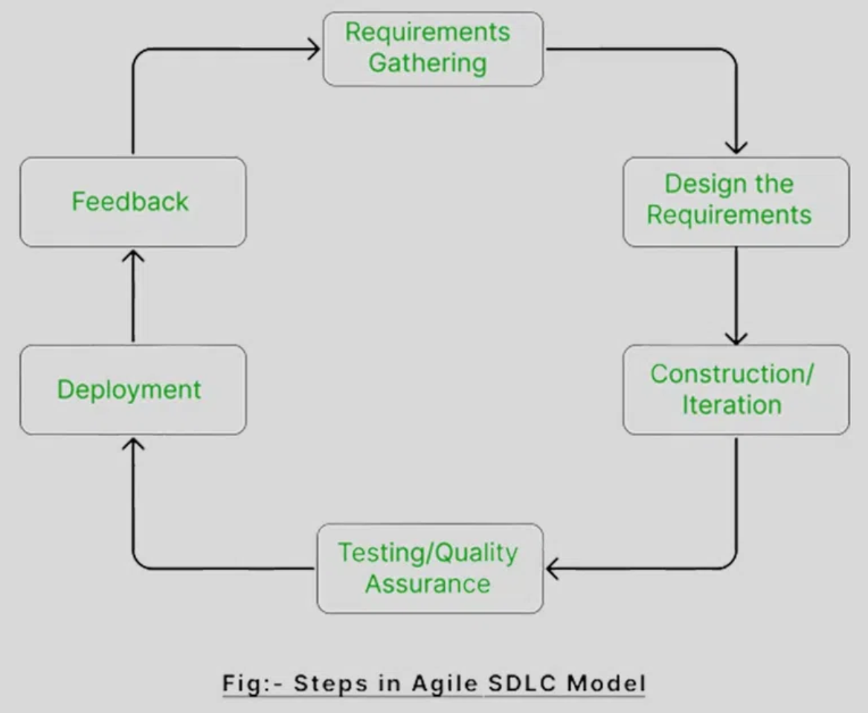

Agile Model – Software Engineering
Agile (Move Quickly)
Large Projects
Small Chunks (Iterations)
Release
Feedback
Enhance
Re-release
Incremental

Slide 8
Important Points:
Advantages:
Frequent Delivery
Face to face Communication with Client
Changes
Time
Disadvantage:
Less documentation
Maintenance Problem

Slide 9

SCRUM:
One of the most popular agile methodology.
Scrum is a lightweight, iterative and incremental framework.
Scrum breaks down the development phases into stages or cycles called "sprints".
The development time for each sprint is maximized and dedicated, thereby managing only one sprint at a time.
Scrum Team has scrum master and product owner with constant communications on the daily basis.
Keywords: Backlog, Sprint, Daily Scrum, Scrum master, Product owner.

Slide 10
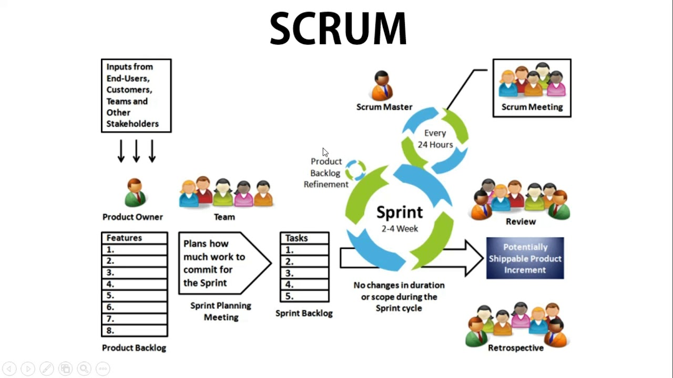

Slide 11
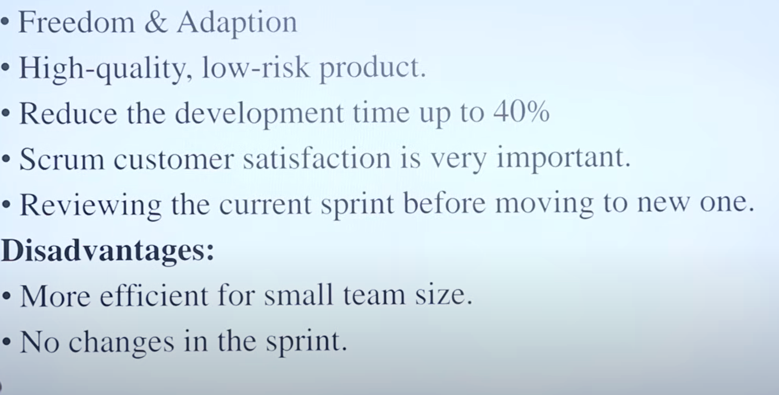

Slide 12
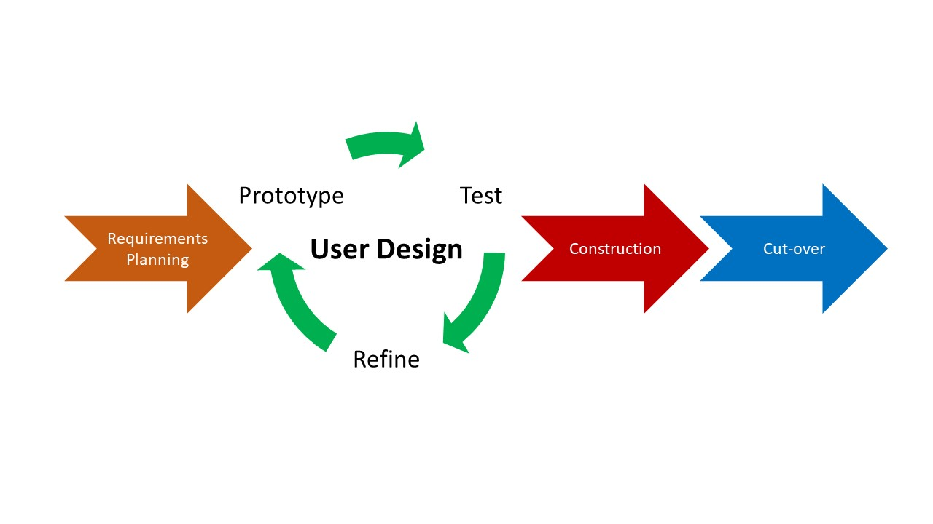
RAD (Rapid Application Development) Model

Slide 13
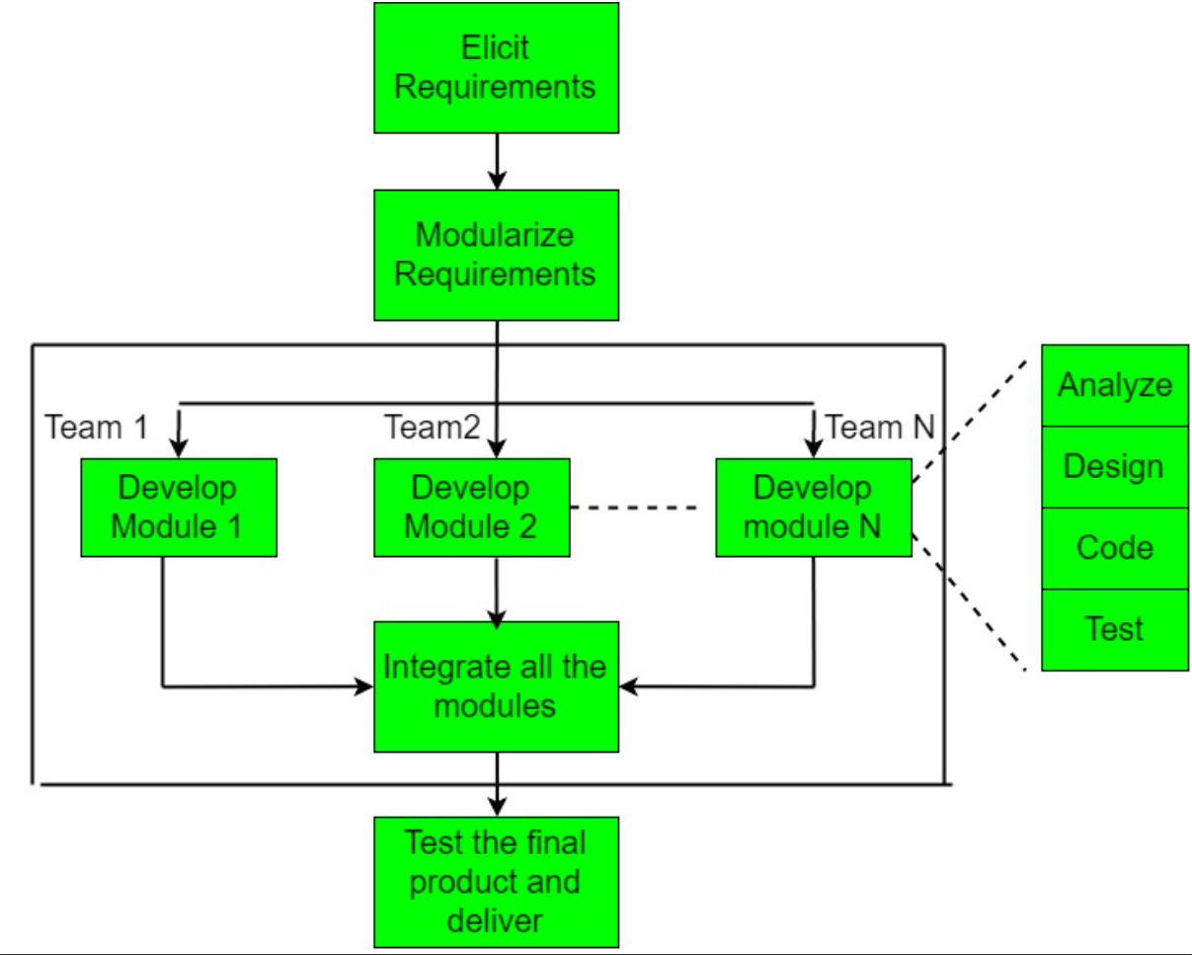
RAD (Rapid Application Development) Model

Slide 14
